Slide 1
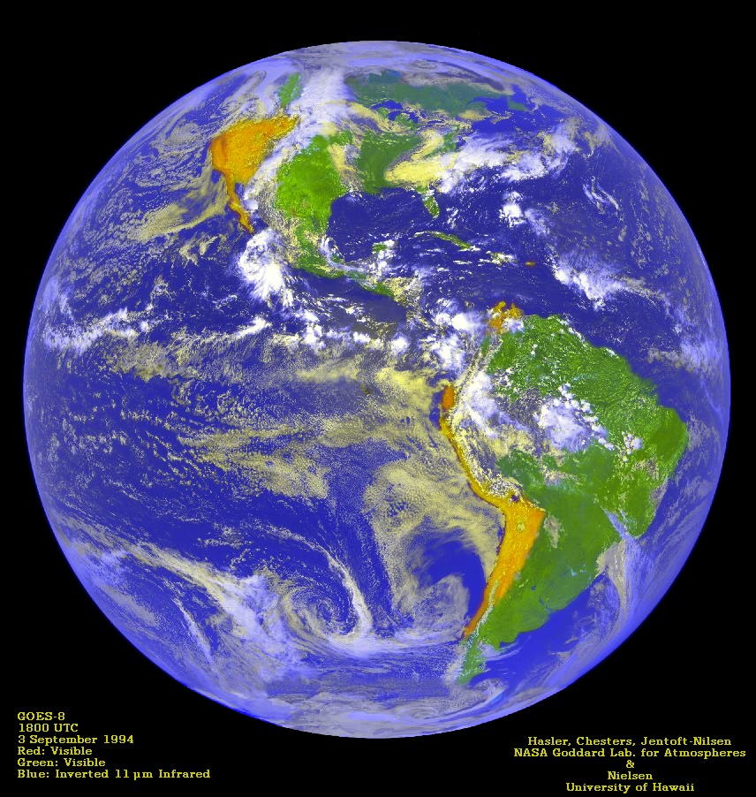
The World Peace Diet
Eating For Spiritual Health and Social Harmony
Presentation by Norman Scrimshaw
Inspired by Will Tuttle’s Book The World Peace Diet

Slide 2
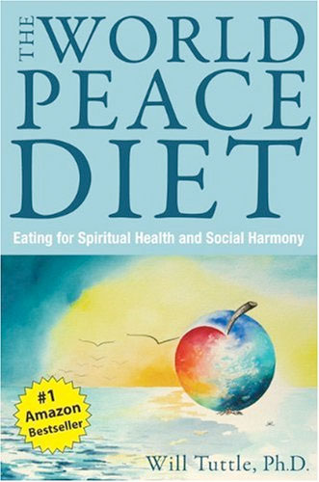

Slide 3
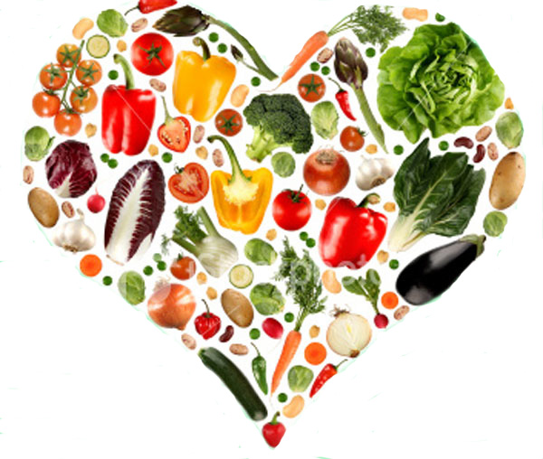
World Peace Diet
VEGAN Diet = Plant Based Diet With a Heart
A Pure Vegetarian Diet, Excluding Animals, Dairy and Eggs as Food

Slide 4
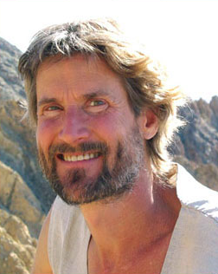
Will Tuttle
Author of The World Peace Diet

Slide 5
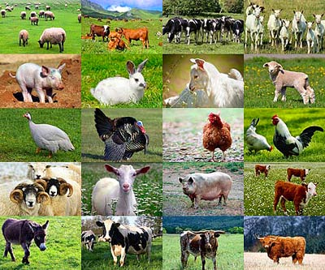
Why Do We Eat Animal Flesh and Their Secretions?

Slide 6
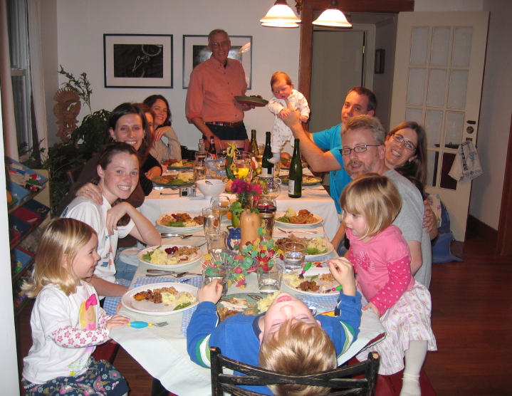
Why do We Eat Animal Flesh and their Secretions?
⬥ Culture & Social Pressure
⬥ We Like the Way Animals Taste
⬥ Belief: It is Needed for Health
⬥ Belief: Animals are for Food & our Use
⬥ Denial of Suffering

Slide 7
Why do We Eat Animal Flesh and their Secretions?
⬥ Culture & Social Pressure
⬥ We Like the Way Animals Taste
⬥ Belief: It is Needed for Health
⬥ Belief: Animals are for Food & our Use
⬥ Denial of Suffering

Slide 8
Why do We Eat Animal Flesh and their Secretions? Culture & Social Pressure

Slide 9
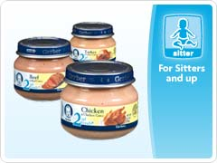
Why do We Eat Animal Flesh and their Secretions? Culture & Social Pressure
What We Eat is Learned from Childhood
“Meat and poultry products:
a good addition to the baby's diet…”
“…So be sure to feed your baby
GERBER FOODS Meats and Poultry with Gravy.”
Belief Programmed:
“Animals,
and Products derived from Animals,
are our Natural Food”

Slide 10
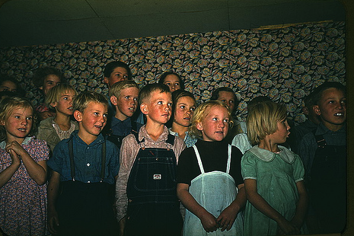
Our Children Learn What to Eat from Us
Are We Making Good Choices for Them?

Slide 11
Why do We Eat Animal Flesh and their Secretions?
⬥ Culture & Social Pressure
⬥ We Like the Way Animals Taste
⬥ Belief: It is Needed for Health
⬥ Belief: Animals are for Food & our Use
⬥ Denial of Suffering

Slide 12
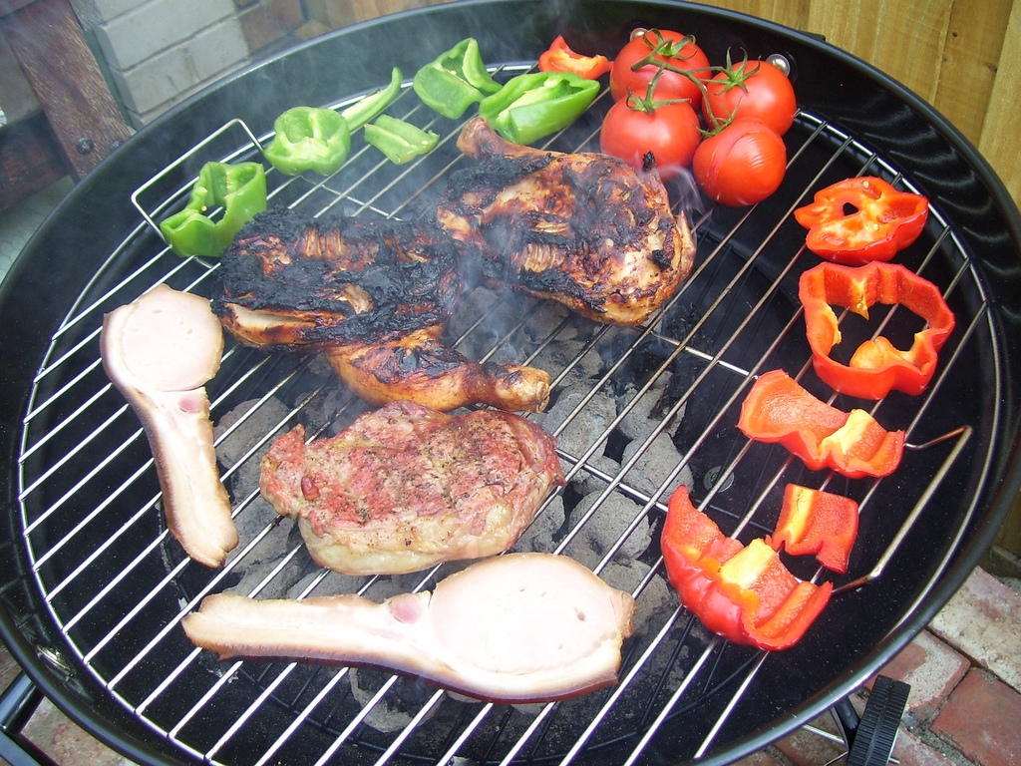
Why do We Eat Animal Flesh and their Secretions? We Like the Way Animals Taste
To Satisfy Our Desires
We Must Live in Denial of Great Suffering
Our Cost:
Shutting Down
Reduction of Essential Feeling and Awareness
Loss of Intuitive Heart Wisdom
Desensitizing, Numbing Resulting in:
Spiritual Disconnectedness
(disconnection from Compassion, Love, Peace and Joy)
Oppression
Exploitation

Slide 13
Why do We Eat Animal Flesh and their Secretions?
⬥ Culture & Social Pressure
⬥ People Like the Way Animals Taste
⬥ Belief: It is Needed for Health
⬥ Belief: Animals are for Food & our Use
⬥ Denial of Suffering

Slide 14
Why do We Eat Animal Flesh and their Secretions? Belief: It is Needed for Health
Where Do I Get My Protein?
I Can’t be Healthy on a Vegan Diet
I am an Athlete, I Require Animal Protein
My Blood Type Requires Me to Eat Meat
I Tried a Vegetarian Diet, and I Didn’t Feel Good

Slide 15
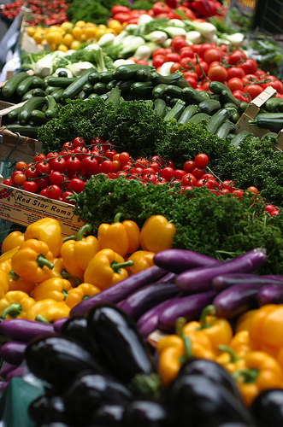
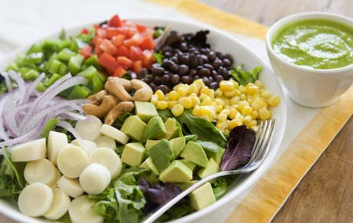
Belief: It is Needed for Health Where Do I Get My Protein?
USDA survey: Average American Vegetarian
Gets 150% RDA of Protein
(Beans, nuts, seeds, soy, whole grains: high in protein)
A Well-Balanced, Plant-Based Diet consists of Vegetables, Fruits, Nuts, Whole Grains and Beans
⬇
Getting Enough Protein is Pretty Simple

Slide 16
Belief: It is Needed for Health Where Do I Get My Protein?
World Health Organization Recommendation 5% Protein
Percentage of Protein in 100 Calories:
Brown rice 8%
Cantaloupe 9%
Apricot 10%
Casaba melon 12%
Buckwheat 13%
Almonds 13%
Walnuts 14%
Oats 15%
Burger King Cheeseburger 21%
Lima beans 22%
Lamb Chops 22%
Great Northern beans 25%
Cauliflower 23%
Asparagus 26%
Peas 27%
Kidney beans 27%
Romaine 28%
Lentils 29%
Mushrooms 31%
Watercress Chinese cabbage 32%
Watercress Chinese cabbage 32%
Tofu 44%
Turkey 41%
Broccoli (frozen) 45%
Spinach (frozen) 51%
"Human breast milk contains approximately 10% of calories from protein,”
"This supplies all the protein needs during infancy, the time of a human's life when protein needs are the highest.
On a diet of 10% protein, an infant will double its weight in 6 months and triple its weight in a year.
How can an adult who is not building new tissue at the same rate possibly need a higher percentage of protein than this?"
Where Do you Get Your Photochemicals? Answer: Plants

Slide 17
Why do We Eat Animal Flesh and their Secretions? Belief: It is Needed for Health
Where Do I Get My Protein?
I Can’t be Healthy on a Vegan Diet
I am an Athlete, I Require Animal Protein
My Blood Type Requires Me to Eat Meat
I Tried a Vegetarian Diet, and I Didn’t Feel Good

Slide 18
“I Can’t be Healthy on a Vegan Diet”
Heart Disease Risk
• Average U.S. Man or Woman > 50% Risk
• Vegan < 5% Risk
Framingham Heart Study:
Cholesterol level below 150 - Essentially “Heart Attack Proof”
• Average Cholesterol Level in the U.S.: 210
• Average Cholesterol Level of U.S. Vegetarians: 161
• Average Cholesterol Level of U.S. Vegans: 133

Slide 19
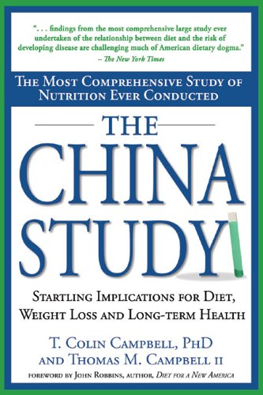
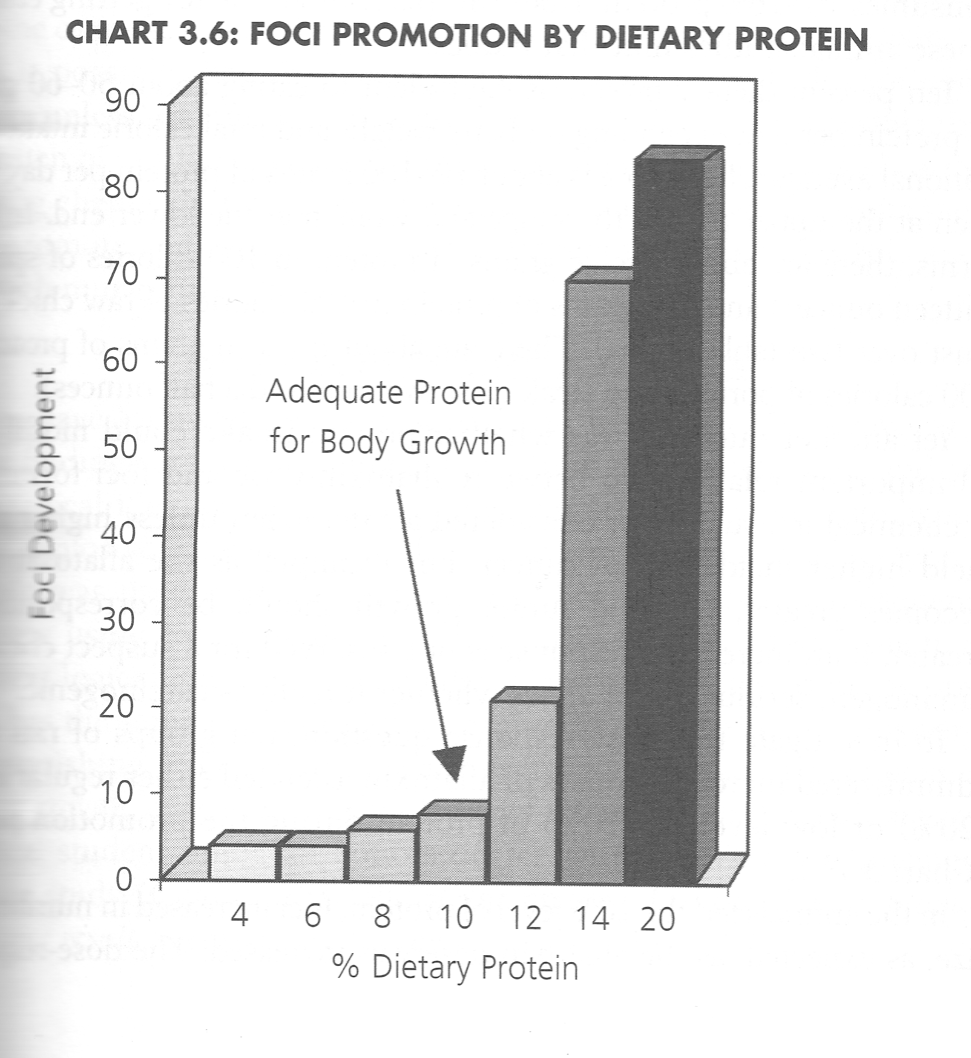
“I Can’t be Healthy on a Vegan Diet”
Animal Protein Significantly Contributes to Cancer
The Largest Study Ever Conducted Showing
a Relationship Between Diet and Disease
60% to 70% of All Cancers Can be Prevented by Eating a Healthy Plant-Based Diet
Animal Protein Significantly Contributes to Cancer

Slide 20
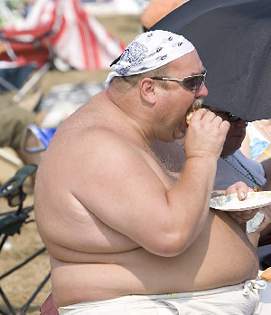
“I Can’t be Healthy on a Vegan Diet”
Obesity and Disease
Increased Risk of Diabetes in Very Obese people 40 Times Greater
Percentage of Overweight Americans, ages 20 and up: 30.5%
Overweight or Obese: US Children 25%
Overweight or Obese: Vegetarian Children : 8%
Obesity Rate: Vegetarians: 6%
Obesity Rate: (Vegans): 2%
Americans Killed Annually by Diseases
due to Excess Weight: 280,000
Population Studies and Clinical Research show the
Effectiveness of a Low-fat, Plant-Based Diet in:
Improving Blood Glucose
Promoting Weight Loss
Reducing Cholesterol
Lowering the Risk of Common Chronic Diseases,
- Diabetes, Heart Disease, Various Cancers

Slide 21
Why do We Eat Animal Flesh and their Secretions? Belief: It is Needed for Health
Where Do I Get My Protein?
I Can’t be Healthy on a Vegan Diet
I am an Athlete, I Require Animal Protein
My Blood Type Requires Me to Eat Meat
I Tried a Vegetarian Diet, and I Didn’t Feel Good

Slide 22
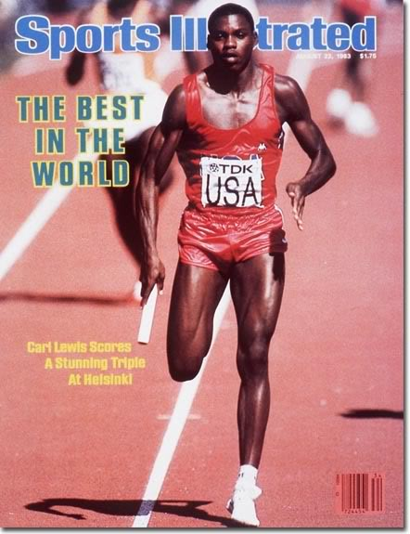
Vegan Athletes
Pat Reeves powerlifter
Robert Cheeke bodybuilder
Johnny Gibbings bodybuilder
Kenneth Williams bodybuilder
Jane Black weightlifter
Weia Reinbound high jumper
Martin Whittred gripper
Robbie Hazeley bodybuilder
Scott Jurek runner
Carl Lewis runner
Fiona Oakes runner
Brendan Brazier tri-athlete
Jason Sager cyclist
Molly Cameron cyclist
Christine Vardaros cyclist
Dr Ruth Heidrich tri-athlete
Rich Roll tri-athlete
Tonya Kay dancer
James Southwood martial artist
Mac Danzig martial artist
Pat Neshek pitcher
Dwayne De Rosario soccer player

Slide 23
Why do We Eat Animal Flesh and their Secretions? Belief: It is Needed for Health
Where Do I Get My Protein?
I am an Athlete, I Require Animal Protein
I Can’t be Healthy on a Vegan Diet
My Blood Type Requires Me to Eat Meat
I Tried a Vegetarian Diet, and I Didn’t Feel Good

Slide 24
“I Can’t be Healthy on a Vegan Diet”
My Blood Type Requires Me to Eat Meat
A Atkins Diet Lose Weight
The Zone Diet
Eat For Your Blood Type
Low Carb Diet
South Beach Diet
Eat for Your Shoe Size

Slide 25
Why do We Eat Animal Flesh and their Secretions? Belief: It is Needed for Health
Where Do I Get My Protein?
I Can’t be Healthy on a Vegan Diet
I am an Athlete, I Require Animal Protein
My Blood Type Requires Me to Eat Meat
I Tried a Vegetarian Diet, and I Didn’t Feel Good

Slide 26
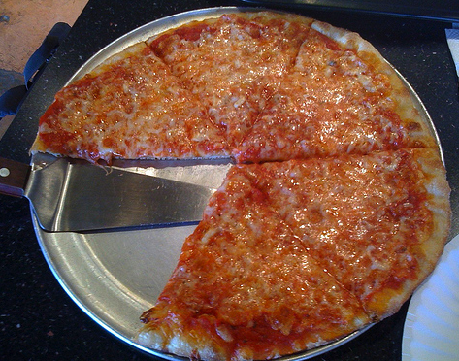
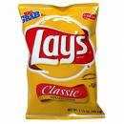
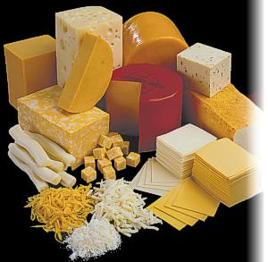
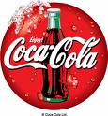
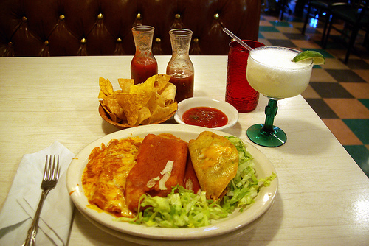
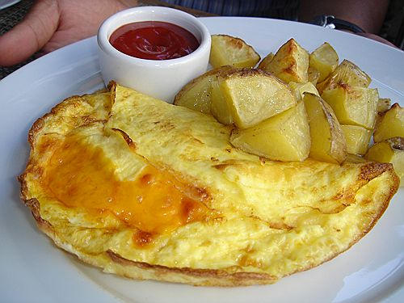
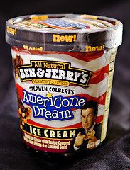
“I Can’t be Healthy on a Vegan Diet”
I Tried a Vegetarian Diet, and I Didn’t Feel Good

Slide 27
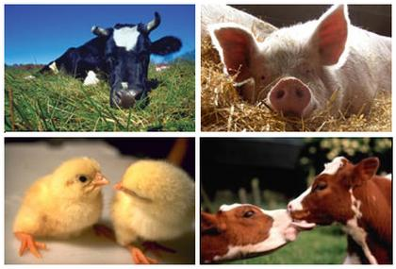
Why do People Eat Animal Flesh and their Secretions? Belief - it is Needed for Health
We Don’t Need to Eat Animals
and Their Secretions to Be Healthy

Slide 28
Why do We Eat Animal Flesh and their Secretions?
⬥ Culture & Social Pressure
⬥ We Like the Way Animals Taste
⬥ Belief: It is Needed for Health
⬥ Belief: Animals are for Food & our Use
⬥ Denial of Suffering

Slide 29
Is this True?
Why do We Eat Animal Flesh and their Secretions? Belief: Animals are for Food & our Use
This Idea, So Prevalent In our Culture,
Is Rarely Challenged or Examined

Slide 30
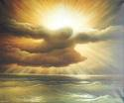
Why do We Eat Animal Flesh and their Secretions? Belief: Animals are for Food & our Use
Where do these Ideas come from?
Where do these ideas come from?
Collective Consciousness
of Our Culture
10,000 Years Ago…
Partnership Societies (Feminine)
Agriculture Connecting (us)
Diet Foraged and Gardened Foods
Worshiped Fertility Goddesses
Used Metals to make Bowls
Did Not Engage in War
Women and Men in Partnerships
Communities in Fertile Valleys
Cooperation – Nurture Inclusive
Dominator Societies (Masculine)
Herding Animals Disconnecting (not us)
Diet Flesh and Milk
Worshiped Fierce Male Gods
Used Metals to make Weapons
Violent Conflict and Competition
Oppression of Women
Communities Fortified Hilltops
Class Strife – Control Exclusive (objects)

Slide 31
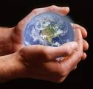
Men and Women as Caretakers
Partnership Society – An Inner Longing

Slide 32
Why do We Eat Animal Flesh and their Secretions?
⬥ Culture & Social Pressure
⬥ We Like the Way Animals Taste
⬥ Belief: It is Needed for Health
⬥ Belief: Animals are for Food & our Use
⬥ Denial of Suffering

Slide 33
Why do We Eat Animal Flesh and their Secretions? Denial of Suffering
The Food We Eat Each Day is Born of Violence and Exploitation
10 billion Land Animals Killed in the US each year
Billions of Animals Raised and Slaughtered in the United States are Factory Farmed
Animals are Viewed as Commodities Not as Living Beings
Corporate Profits Determine How Animals are Treated
The Resulting Suffering is Horrifying and Shameful
Animal Agriculture is Unsustainable
Environmental Destruction
Squandering of Precious Resources
World Hunger
The current industrial farm animal production (IFAP) system poses unacceptable risks to public health, the environment and the welfare of the animals themselves –Pew Commission on Industrial Farm Animal Production 2008

Slide 34
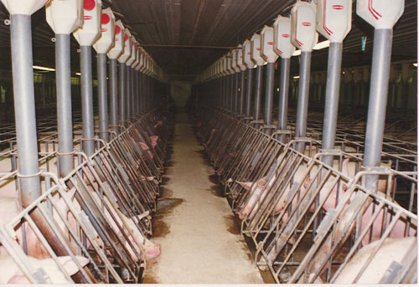
Denial of Suffering…
This is Not a Cartoon
Throughout Their 112-115 Day Pregnancies,
80% of Breeding Sows in the United States
are Confined in Gestation Crates...

Slide 35
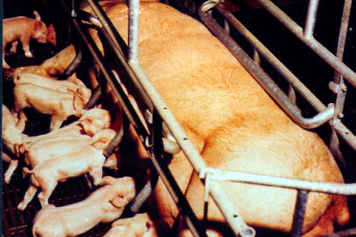
Denial of Suffering…
This is The Real World
Jail House Moms

Slide 36
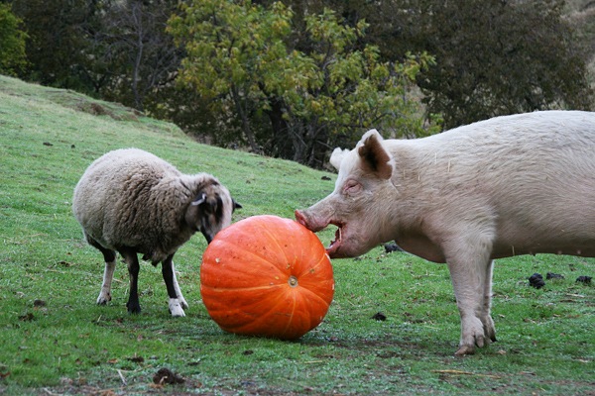
Denial of Suffering…
Pigs Need a Life Too

Slide 37
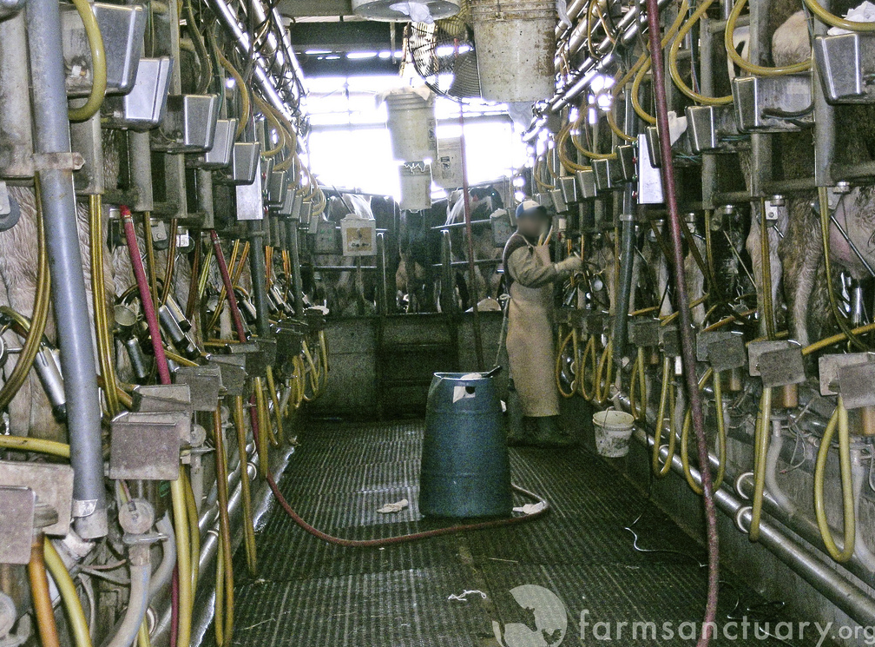
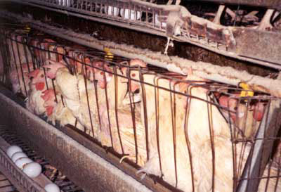
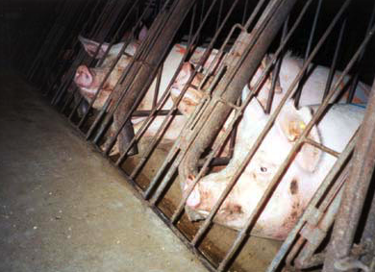
Denial of Suffering…
Domination of The Feminine

Slide 38
Got Milk
Denial of Suffering…
Got Milk

Slide 39
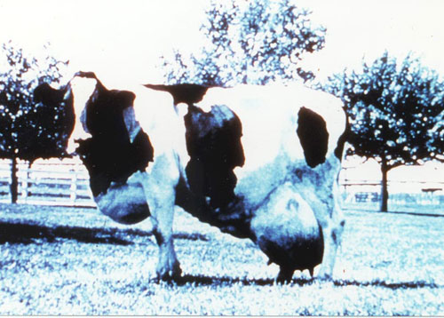
Denial of Suffering…
Animals are pumped full of bovine growth hormone (BGH), which contributes to painful inflammation of the udder known as “mastitis.
In order to force the animals to continue giving milk, factory farmers impregnate them using artificial insemination every year
Cows are forced to be carnivores and fed rendered animals to increase milk production
Factory farmers force cows to produce
about 10 times as much milk
as they naturally would.

Slide 40
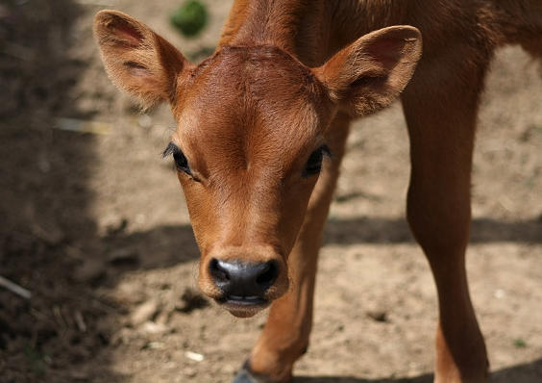
Denial of Suffering…
Stealing Milk
Male Calves, “by-products” of the Dairy Industry,
are generally taken from their mothers
when they are less than 1 day old

Slide 41
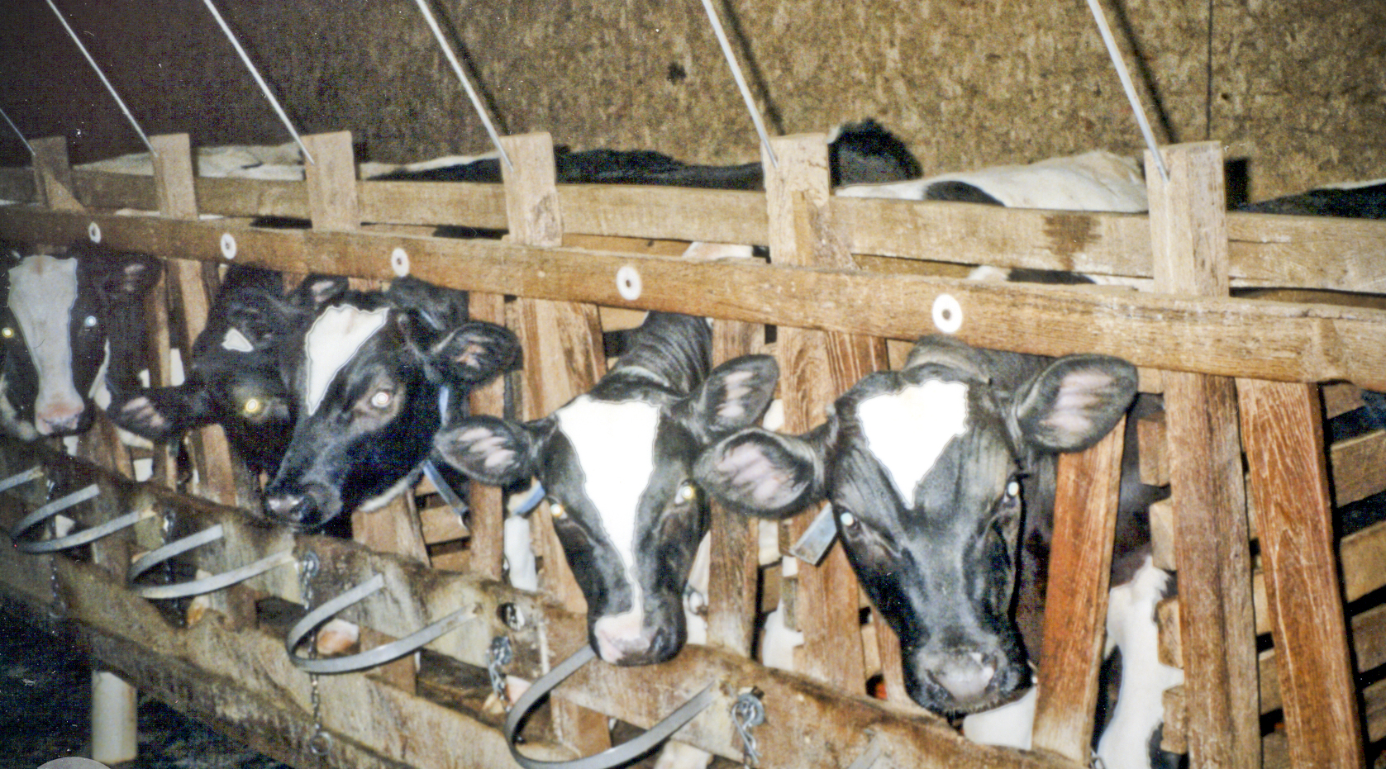
Denial of Suffering…
“Veal” is the Flesh of a Tortured, Sick Baby Cow,
and a By-Product of the Milk Industry.

Slide 42
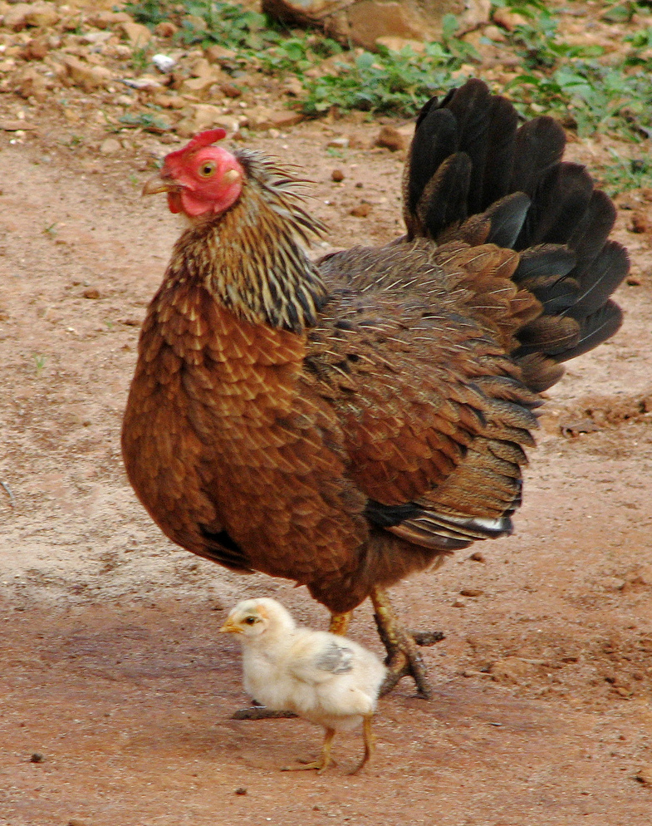
Proud Mom
Proud Mom

Slide 43
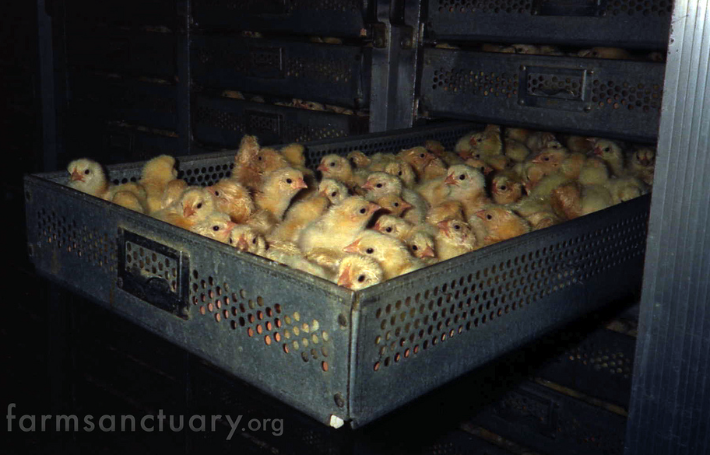
Denial of Suffering…
These Chicks will Never Know Their Moms

Slide 44
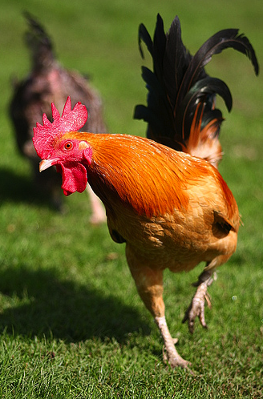
Proud Mom
Broilers and Layers

Slide 45
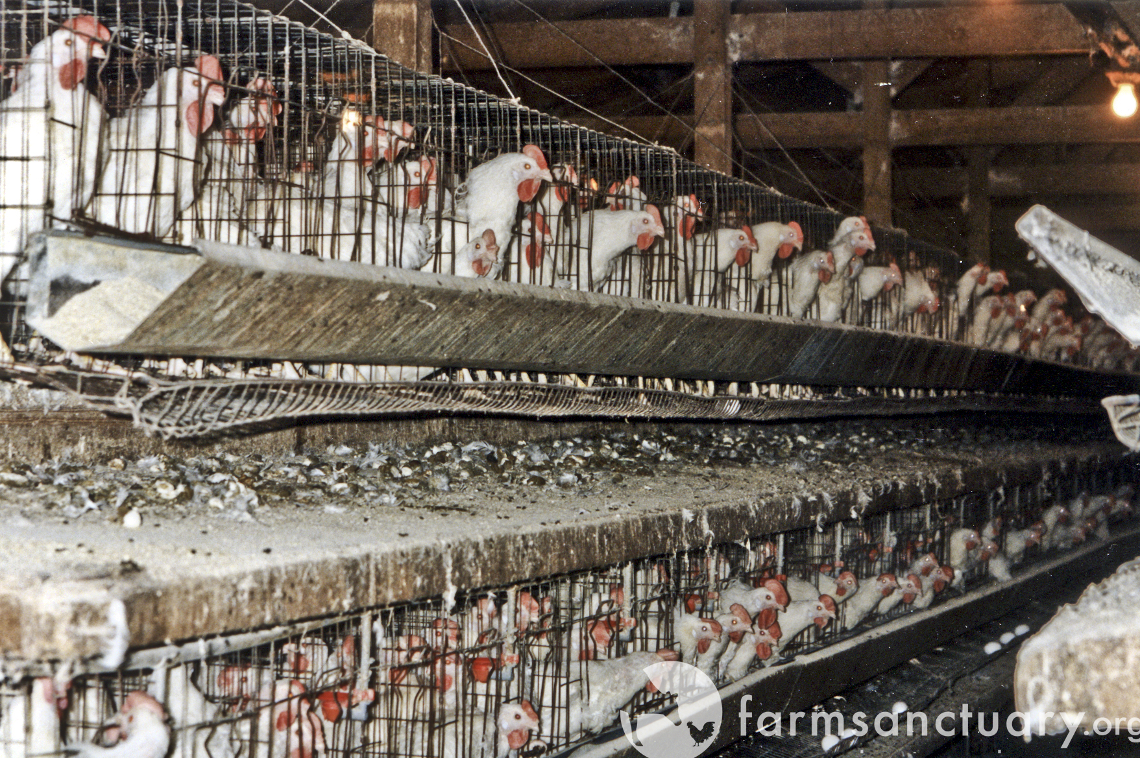
Denial of Suffering…
Jail House Blues

Slide 46
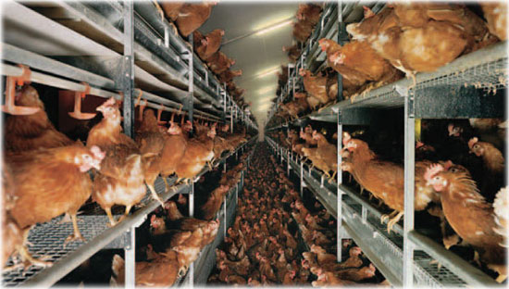
Denial of Suffering…
“Cage Free” Hens
“Cage-free” hens are typically confined in dark, crowded buildings filled with toxic gases and disease microbes, the same as their battery-caged sisters.
“Cage-free” hens, like the battery-caged sisters,
are painfully debeaked at the hatchery.

Slide 47
Denial of Suffering…
Deceptive Labels
Despite the “certified humane” logo, visitors were shocked to find 100,000 debeaked hens crowded into five 400 ft long sheds, each holding “a sea of 20,000 brown hens”, so densely crowded the floor was invisible.
The “range,” even if the hens had been outside, was just “a bare patch of dirt between the sheds.”

Slide 48
Denial of Suffering…
Eggs a Product of Misery
“If man wants freedom, why keep birds and animals in cages?
Truly man is the king of beasts, for his brutality exceeds them.
We live by the death of others. We are burial places!
I have since an early age abjured the use of meat.”
Leonardo Da Vinci

Slide 49
An Independent Spirit
Life and Vitality

Slide 50
Denial of Suffering…
Broilers
Spirit Broken

Slide 51
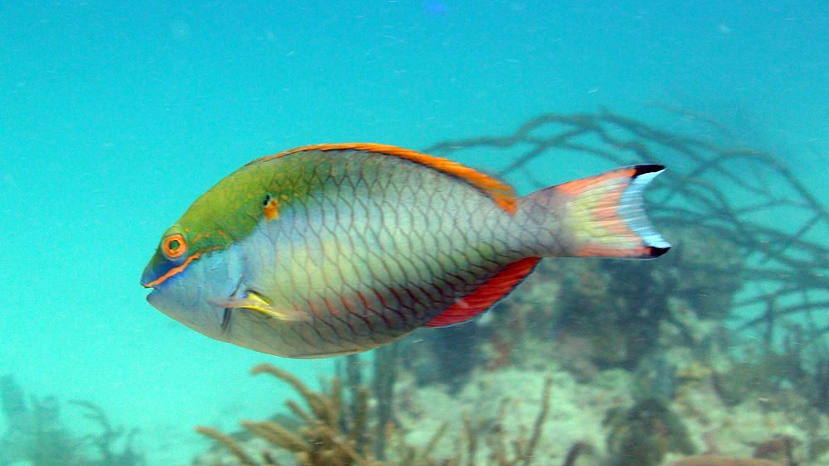
Denial of Suffering…
Fishing Hurts
Anatomically, Psychologically,
and Biologically,
the pain system in fish is virtually the same as in birds and mammals…
Dr Donald Bloom, scientist at Cambridge University and animal welfare advisor to the British government
Fish lead complex intellectual lives that rival those of dogs and some other mammals.
The pain a fish feels when it is hooked is like dentistry without Novocain drilling into exposed areas….
Dr Tom Hopkins, professor of Marine Science at the University of Alabama

Slide 52
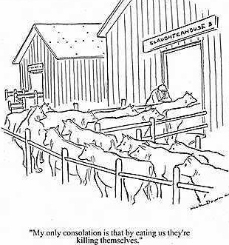
Denial of Suffering…
Slaughterhouses “Animal Disassembly Lines”
If slaughterhouses
had glass walls,
everyone would be a vegetarian. ~ Paul McCartney
Think occasionally of the suffering of which you spare yourself the sight Dr. Albert Schweitzer

Slide 53
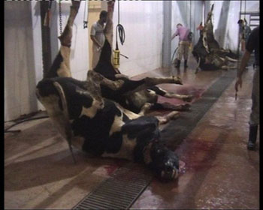
Denial of Suffering…
They die,’ said Moreno, ‘piece by piece.’
In plants all over the United States, this happens on a daily basis
Lester Friedlander former Chief Government Inspector
Notes:
Moreno’s job was to cut the hocks off carcasses on the line inside the meat processing plant.
The carcasses would whirl past at a rate of 309 an hour.
The cattle were supposed to be dead before they got to Moreno. But too often they weren’t. “They blink. They make noises, ‘The head moves, the eyes are wide and looking around.”
“Still Moreno would cut. On bad days, he says, dozens of animals reached his station clearly alive and conscious.
Some would survive as far as the tail cutter, the belly ripper, the hide puller.

Slide 54
Denial of Suffering…
“You have just dined, and however scrupulously the slaughterhouse is concealed in the graceful distance of miles, there is complicity.”
~ Ralph Waldo Emerson

Slide 55
The Environment
Compassion for the Earth

Slide 56
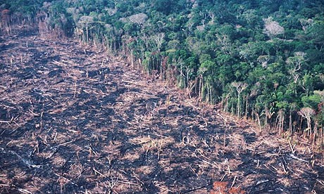
Animal Agriculture is Harmful to the Environment
Rain Forest Devastation

Slide 57
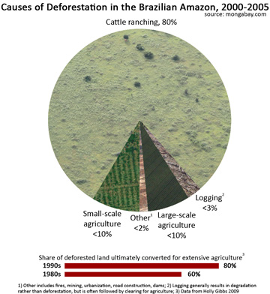
Animal Agriculture is Harmful to the Environment
Our Diet and Deforestation
80% of Rain Forest Deforestation
in Brazil is due to Cattle Ranching
Holly Gibbs, PhD
Stanford University Researcher (2009)
80% of World Deforestation
is because of Animal Agriculture
David Pimentel, PhD
Cornell University Researcher

Slide 58
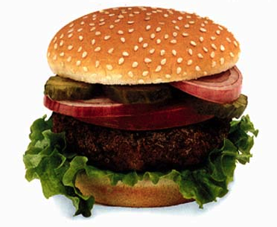
Animal Agriculture is Harmful to the Environment
12 pounds
of grain
55 square feet
of rainforest
2,500 gallons
of water
Make a difference 3 times a day
Shift to a plant-based diet

Slide 59
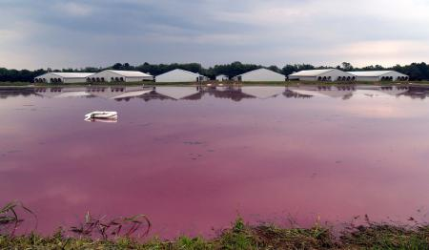
Animal Agriculture
Is Harmful to the Environment
The Animals we raise to eat far outnumber us.
9.7 Billion land animals killed for food in 2000 in US (USDA)
We Aren’t Managing the Waste Products They Produce
Animal Agriculture is Polluting our World.

Slide 60
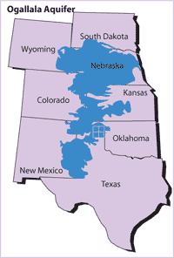
Animal Agriculture is Harmful to the Environment
Water Use from Animal Agriculture
The Production of Beef in America uses far more Water from the Ogallala Aquifer than the Production of All Fruits and Vegetables Combined…
To Produce One lb of:
Steak: 2,500 gallons
Pork: 1,600 gallons
Lettuce, Wheat,
Tomatoes, or Potatoes: ≤ 25 gallons
Water needed to produce daily diet:
Average American meat-eater: 4,000 gallons
Average Vegan: 300 gallons

Slide 61
We Can Make Better Use of Our Land
Animal Agriculture is Harmful to the Environment
80% of U.S. Agricultural Land
Used for Feed Grains for Animal Farms
Amount of Land Needed to Feed:
1 Vegan for a Year: 1/6 acre
1 Meat-Eater for a Year: 2.5 acres (about 15 times as much)
1.02 Billion People in this World are Living in Hunger
"Earth provides enough to satisfy every man’s need,
but not every man’s greed.” - Mahatma Ghandi

Slide 62
Animal Agriculture is Harmful to the Environment
Producing Animal Foods
Requires Immense Quantities of Petroleum
Animal Agriculture Contributes Disproportionately to our Consumption of Petroleum…
Our Cost:
Air and Water Pollution
Global Warming
Wars driven by Conflict over
Dwindling Petroleum Reserves
If Americans were to reduce meat consumption by just 20 percent it would be as if we all switched from a standard sedan—a Camry, say—to the ultra-efficient Prius.”
New York Times Article 2008
To Produce 1 Calorie of Protein:
Soybeans 2 Calories of Petroleum
Wheat and Corn 3 Calories of Petroleum
Beef 54 Calories of Petroleum
.
In 2002, more than 1/3 of all fossil fuels produced in the United States was used to raise animals
E/The Environmental Magazine

Slide 63
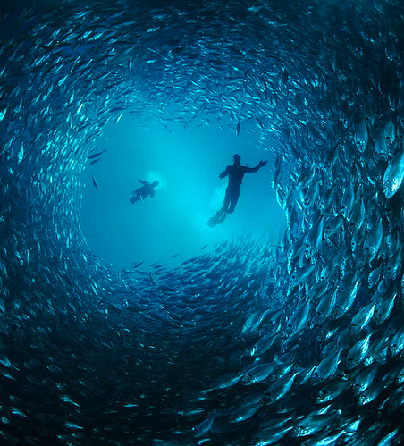
Beauty Beneath The Waves

Slide 64
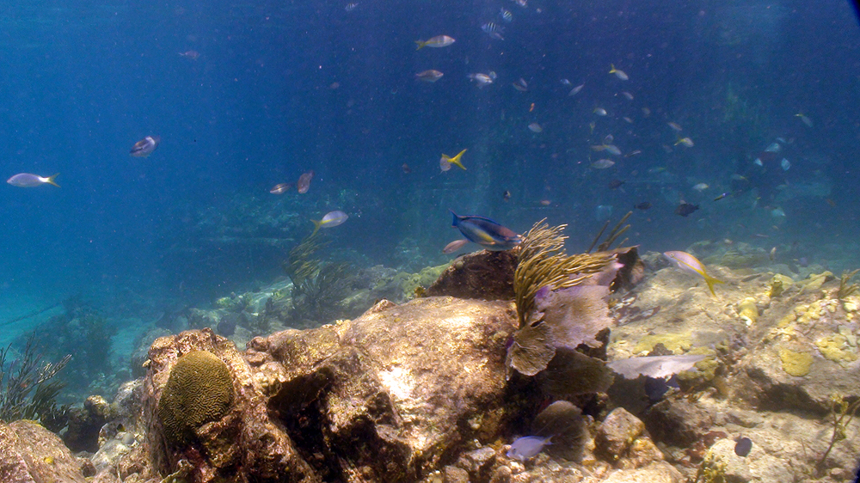
Beauty Beneath The Waves
Coral reefs are home to more than 25% of all known Marine Fish Species

Slide 65
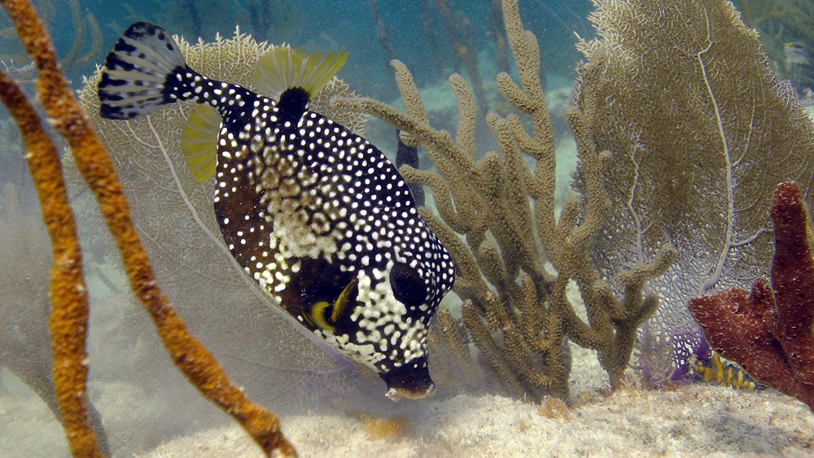
Marine Life Destruction
Half the Fish Caught are Wasted to Grow Billions of Animals Big and Fat Profitably
27% of World's Coral Reefs Already Lost
60% of World's Coral Reefs will be Destroyed over the next 30 years
(if present rates of destruction are allowed to continue)
Coral Reefs are Home to More than 25% of All Known Marine Fish Species
(they occupy < ¼ of 1% of marine environment)
Commercial Fishing:
Kills Hundreds of Billions
of Sea Life every Year
Has decimated our
Ocean Ecosystems
90 % of Large Fish Populations Exterminated in the past 50 years
(It takes 5 lbs of Wild Ocean Fish to produce 1lb of Farmed Shrimp or Fish)

Slide 66
Animals are Sentient Beings
Like Us, Animals:
Have a Will to Live
Experience Pain
Experience Fear
Experience Trauma
Know Love
Experience Joy
Can be Playful
Are Maternal
Are Social

Slide 67
A Kiss from Mama
Animals are Sentient Beings

Slide 68
Best Friends
Animals are Sentient Beings

Slide 69
Elephant Joy
Animals are Sentient Beings

Slide 70
Peaceful Coexistence
Animals are Sentient Beings

Slide 71
Animals are Sentient Beings
Love

Slide 72
Tenderness
Animals are Sentient Beings

Slide 73
Suffering Mental and Physical
Animals are Sentient Beings

Slide 74
Innocence Deserves our Protection
Animals are Sentient Beings

Slide 75
Animals are Sentient Beings
To Be Our Food
Is Not The Purpose Of Animals
Animals Have Their Own Purpose

Slide 76
The Idea That Animals are Here For Our Use Is Egocentric
The Universe
Other People
ME
The Earth
Animals

Slide 77
Animals are Sentient Beings
Speciesism
spe·cies·ism noun
discrimination against or exploitation of animals based on the assumption that humans are superior to and more important than all other species
Webster’s New World College Dictionary
L

Slide 78
It is just like man's vanity and impertinence to call an animal dumb because it is dumb to his dull perceptions Mark Twain
How would you feel about? …….

Slide 79
How Would You Feel About Being Lunch For a More Technologically Advanced Species?

Slide 80
Animals are Sentient Beings
Power - Technology - Domination
This is Not Valid Criteria to Assert Superiority Over Other Animals
We Don’t Need to Eat and Abuse Animals to Survive
The Violence of Our Diet is Reflected in Our World
- We Are the Most Violent and Destructive Animals on Earth
- We Fight and Kill Each Other
- We Enslave and Torture
- We Threaten the Existence of the Whole Earth
“The cycle of violence that starts on our dinner tables reverberates
through our families, our communities, and through all our relations,
rippling into the field of our shared awareness.” Will Tuttle

Slide 81
We Are All Sentient Beings
The Cycle of Violence ends with the understanding of the interconnectedness of all life and the fundamentally spiritual nature of all beings.
No being is merely a material thing or object, and thus,
no being can ever be a commodity or article of property
Our Survival as a Species Depends on Our Spiritual Evolution
Evolution Implies Not Only Change but Transformation
Compassion is the True Spiritual Evolution

Slide 82
The Pythagorean Theorem
For as long as men massacre animals, they will kill each other. Indeed, he who sows the seed of murder and pain cannot reap joy and love." Pythagoras, Mathematician

Slide 83
Our True Nature Is Compassion
Compassion is the True Spiritual Evolution

Slide 84
Nothing will benefit human health and increase chances of survival for life on earth as much as the evolution to a vegetarian diet Albert Einstein, Physicist
Nobel Prize 1921
Until he extends the circle of compassion to all living things, man will not himself find peace
Albert Schweitzer
The Philosophy of Civilization

Slide 85
I-Thou vs I-It
Our True Nature Is Compassion
Martin Buber
I See You

Slide 86
All Beings are intimately connected to each other and all living things in the Web of Life
Our True Nature Is Compassion
It Is Time For a New Paradigm
Living with a Reverence for All Life

Slide 87
Bring Your Fresh Flower to the World
Our True Nature Is Compassion
Be The Change You Want To See in the World
Mahatma Gandhi
Thich Nat Hahn

Slide 88
BE GLAD THAT WE ARE ALL ALIVE !

Slide 90
Loving Kindness Meditation The Metta Prayer
May I be safe
May I be free from suffering
May my heart remain open
May I know the beauty of my own true nature
May I be joyful
May I be healed
May I be peaceful
May all beings be safe
May all beings be free from suffering
May all beings hearts remain open
May all beings know the beauty of their own true nature
May all beings be joyful
May all beings be healed
May all beings be peaceful

